Slide 1
Employee Salaries for different job roles
Mennatallah EL-Khateeb
Welcome to the Employee Salaries for Different Job Roles Dataset! This dataset provides valuable insights into the compensation and job roles of employees across various industries and regions. Whether you're an HR analyst, data scientist, or someone interested in understanding salary trends, this dataset offers a wealth of information to explore and analyze.

Slide 2
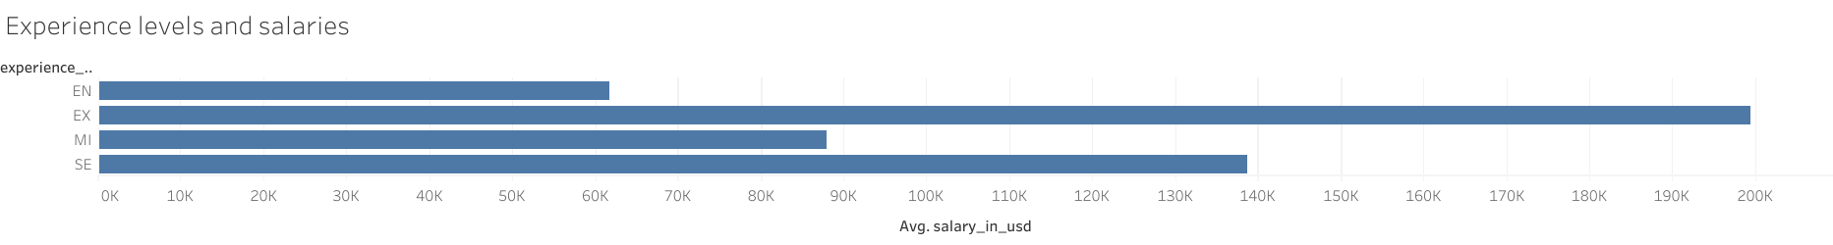
Salary Relationship to Employees' Level of Experience
Note that the most salaries for employees have a high level of experience and the salaries are lower by dependence to the level of experience

Slide 3
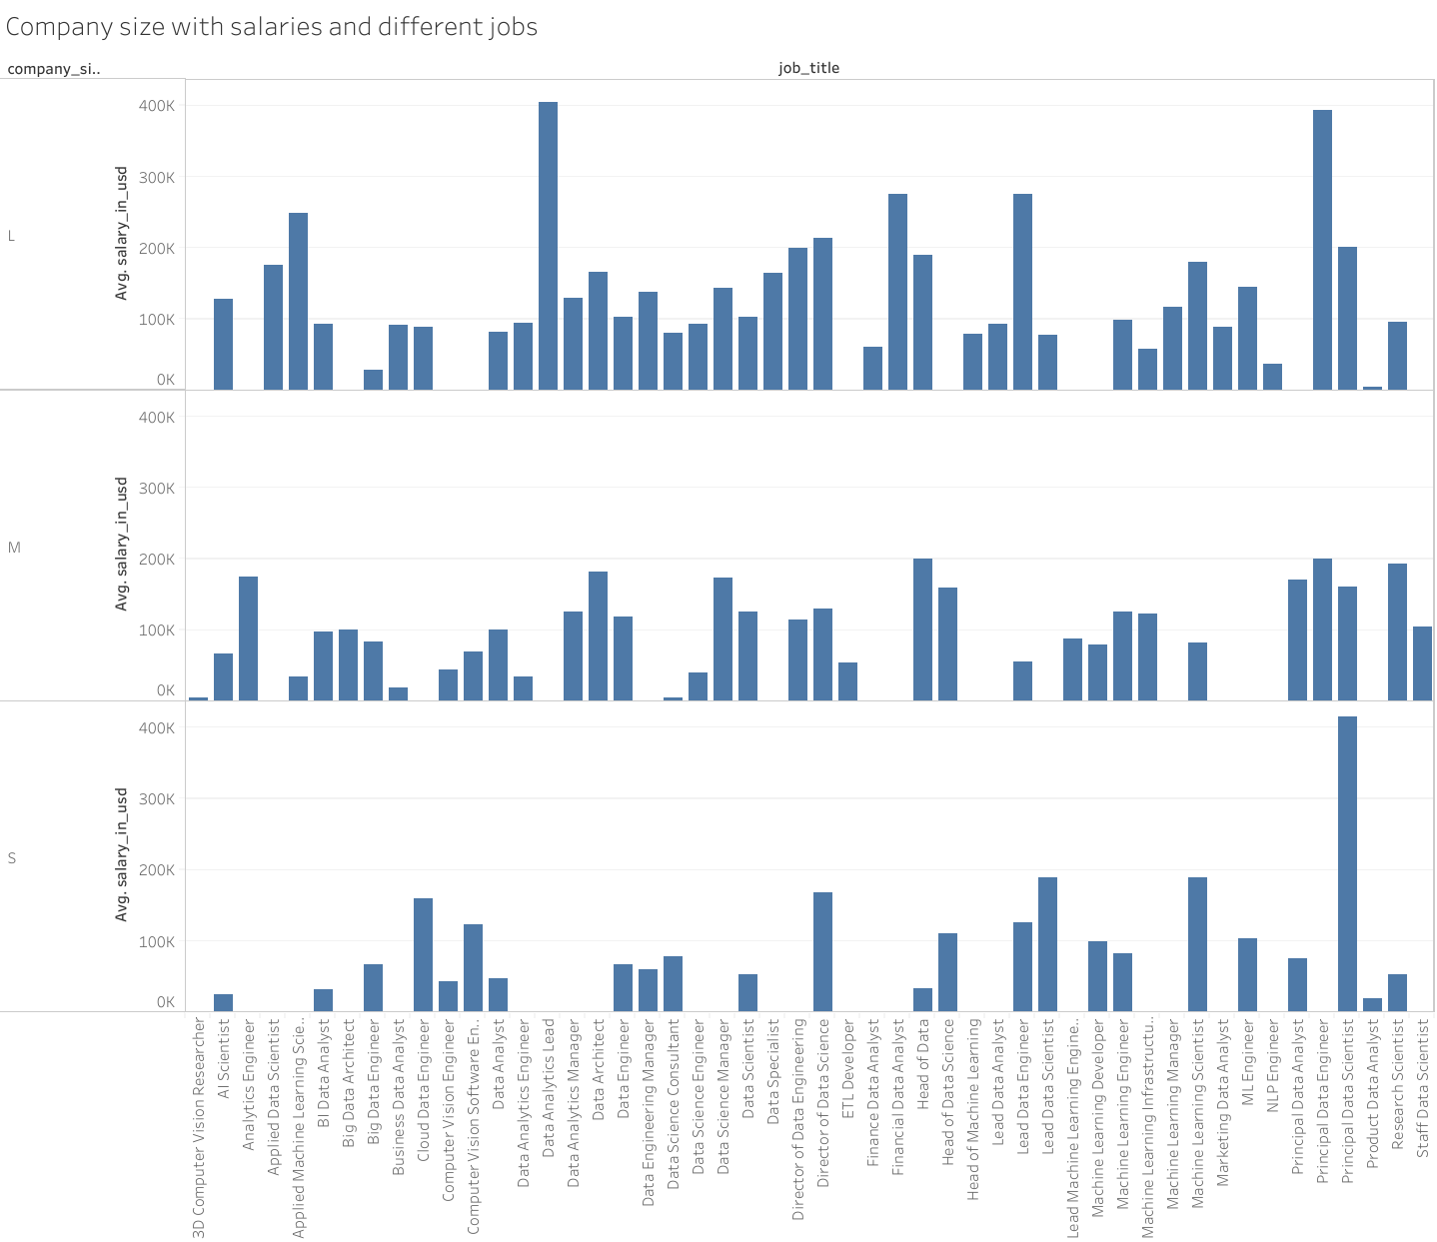
Salary level and jobs with company size
Note that there are no jobs in small companies such as lead
data analyst Also notes the high salaries for some jobs while increasing the size of the company such as data engineer

Slide 4
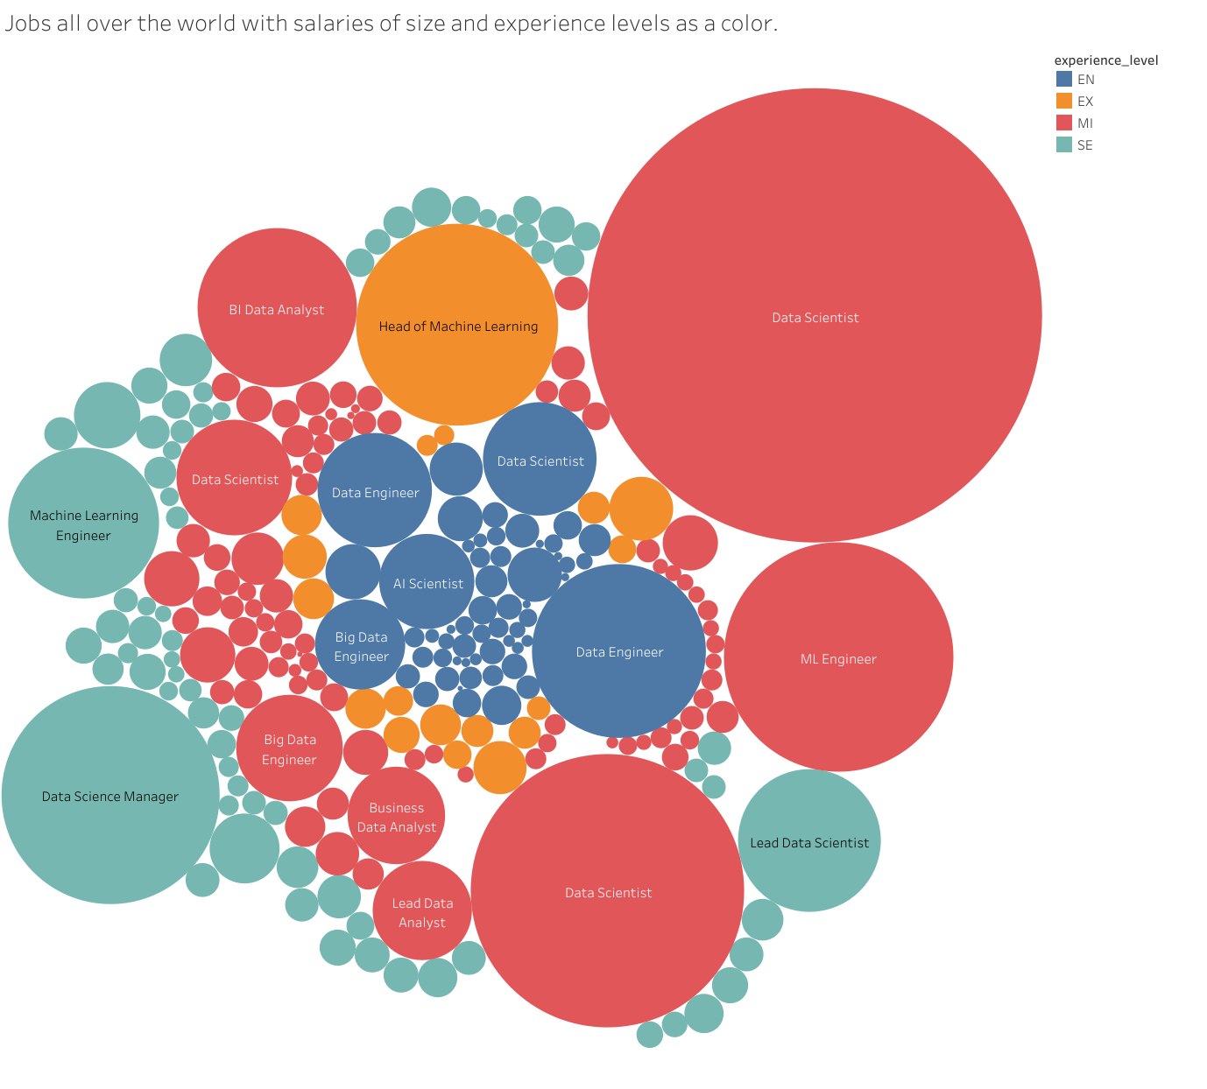
Jobs and salaries with the levels of experience
Note that the most salary-wise job is the data Scientist, although at the Mid-level of experience.
The most highly experienced job is Head of maching learning
The most salaried job in entry-level is Data Engineer
The most salaried job in Senior is Data Science Manager

Slide 5
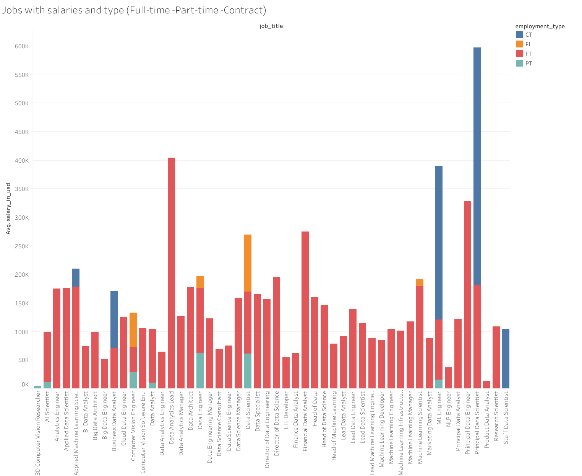
Jobs with salaries and normal job contract
Note that the most salary function of the contract nature is the Principle Data Scientist
Note that most job of a full-time nature in terms of salaries is Data Analysis Lead

Slide 6
